Slide 1
Data Management for Machine Learning
Sunil Bhutada
Guest Faculty

Slide 2
Course Number DSE* ZG529 / AIML* ZG529
Course Title Data Management for Machine Learning
Lecture No. 2

Slide 3
CS – 2 Data Management Fundamentals

Slide 4
Agenda
Principles of Data
Data Management
Data Platform
DM Components
Phase of data life cycle
DM Roles
Connecting Dots

Slide 5
Principles of Data

Slide 6
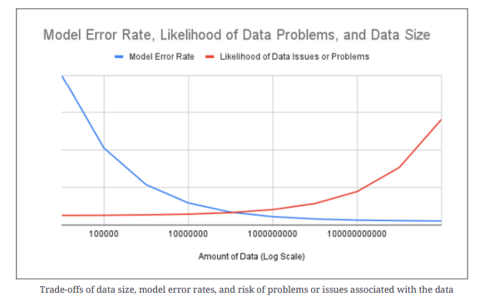
Data As Asset
Data as Asset
Data as Liability
Data Sensitivity of ML Pipelines
Data Reliability
What this graph says? Your views?
The graph shows the relationship between data size (on a log scale) and two metrics:
Model Error Rate (Blue Line) – it decreases sharply as data size increases, indicating that larger datasets generally improve model accuracy and reduce errors.
Likelihood of Data Issues or Problems (Red Line) – it starts low but rises with very large data sizes, meaning bigger datasets increase the chance of data quality problems (e.g., noise, inconsistencies).
In short, the chart illustrates a trade‑off: while more data improves model performance, it also raises the risk of data‑related issues that need management

Slide 7
Data As Asset
Data as Asset
Data as Liability
Data Sensitivity of ML Pipelines
Data Reliability
Can you imagine a ML system without data?
Case Study: Netflix
(https://research.netflix.com/research-area/analytics)
“We are able to provide efficient and actionable data-informed perspectives that help Netflix think critically and differently about its business and ultimately improve our service”
What this implies?
Data is an important asset
For a successful business model, data is key
Transform data to value for successful business
Truthful Pain: It is not easy to collect relevant data

Slide 8
Data As Liability
Data as Asset
Data as Liability
Data Sensitivity of ML Pipelines
Data Reliability
Very Basics of Data Management
Collect
Store
Delete
Problem Statement:
One man’s food is other man’s poison
Similarly anything can be an asset or liability basis the circumstances
Holds good for data as well
How Data can become liability?
Exposure to unexpected shades of collected data
Not considering this can harm us as well as end users
Example:
Medical records – can be an asset or liability if exposed unnecessarily
“In the context of healthcare, the potential legal and ethical risks associated with storing and managing sensitive patient medical records, where a breach or misuse of this data could lead to significant consequences for the healthcare provider, including lawsuits and reputational damage; essentially, the sensitive nature of medical information means that mishandling it can create legal liability for the entity responsible for its storage and access. ”

Slide 9
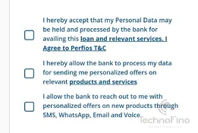
Data As Liability
The biggest Myth
More data == better
This stuff is easy
Data as Asset
Data as Liability
Data Sensitivity of ML Pipelines
Data Reliability
Challenges at Phase
Collect
Store
Delete
You would have seen this, when applying for loans/credit cards, etc.
Compliances:
Location of organization ( Eg: In employer can store employees’ data in In servers)
Location of data origin(Eg: European Union data cannot exit the region)
Organization policies (Eg: Confidential data of the organization)
Restrictions:
Data about people(PII?)
Permission to store data(how?)
Storage(how?)
Retrieval of permission(how?)
Access to the data provider(how?, when? and why?)
Sources of restrictions:
Governing laws
Industry practices
Insurance regulations
Corporate governance policies
Restrictions In Data Collection
A Classic example of collecting PII(Personally Identifiable Information) - Per law, this needs an explicit consent along with deletion criteria

Slide 10
Data As Liability
The biggest Myth
More data == better
This stuff is easy
Data as Asset
Data as Liability
Data Sensitivity of ML Pipelines
Data Reliability
Challenges at Phase
Collect
Store
Delete
Approach 1 : Access Restriction
Access restrictions(external and internal)
Restrict even employees accessing or modifying the private user data. If needed then,
Impose granular restrictions
Enable detailed logging to trace back
Approach 2 : Anonymization of Data
To reduce the data access and auditing surface
Pseudonymization
Eg: Postcode. For weather predictions, a diff post code from the same locality can be given.
Replace private identifiers with others in a reversible fashion
Reversing needs access to additional data or systems
Protects data from casual inspection by engineers along the pipeline
Preserves the properties of data that are relevant to the model(Eg: Postcode from same locality)
Approach 3 (Recommended) : Connection Removal
Remove connection between private data(PII) and model data
Reduces the risk
Harder than it seems
Not trivially reversible but still valuable can be difficult

Slide 11
Data As Liability
The biggest Myth
More data == better
This stuff is easy
Data as Asset
Data as Liability
Data Sensitivity of ML Pipelines
Data Reliability
Challenges at Phase
Collect
Store
Delete
When will you delete data?
When the user mentions a specific time period
When the org no longer need that data
Eg:
Have you noticed companies’ job portals which says that your data/profile details will be retained for 6 months only?
After that you have to recreate your profile in the companies’ job portal.
When the governing policies sets a cut off(Eg: GDPR)
Harder than we speak
When you say Shift+Del – what happens the actual data ?
How the recovery software's can restore the data in any device?
Eg:
Consider a system where data is written on to tape drive for archival purpose. Now deleting data in primary system is possible, but how will you delete data from tapes?

Slide 12
Data Sensitivity of ML Pipelines
Data as Asset
Data as Liability
Data Sensitivity of ML Pipelines
Data Reliability
Scenario:
An ecommerce company wants to predict the new year eve sales, ie sales on Dec 31st, from all the countries, region or language.
They also want to study some trend based on the language.
Now due to some technical or human error, they lost data from a particular country or region or language.
The data pipeline was still executing normally while ML pipeline was behaving so differently.
Can you reason out why?
Data pipeline is not predicting anything, so it can work as usual
But ML pipeline includes the model as well
So if the right data is not supplied then ML pipelines behave abnormally bringing down the performance as well as the accuracy
Now in the scenario, any of the omission can result in incorrect prediction and impact the sales and reputation of the ecommerce company
Normal data pipelines are sensitive to
Volume of input data
Correctness of input data
ML Pipelines are sensitive to
Changes to distribution of data
Volume of input data
Correctness of input data

Slide 13
Data Reliability
Data as Asset
Data as Liability
Data Sensitivity of ML Pipelines
Data Reliability
In the growing distributed environment, what are the minimum characteristics expected from data?
After some time, what will happen if the needed data is lost?
Durability
Are we not supposed to get same data from all its copies?
Consistency
In a team, where the data changes frequently, don’t we want to time travel?
Leads to the character
Version control
How fast the data should be available to get accurate answers?
Performance
Availability
As and when we need is the data available?
Home Work: Find out why integrity is not there

Slide 14
Data Management

Slide 15
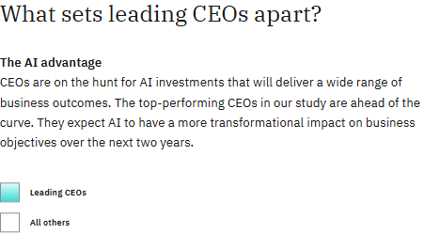
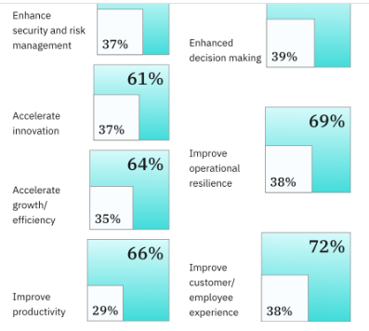
A Study by IBM
72% of top-performing CEOs agree that competitive advantage depends on who has the most advanced generative AI.
What this conveys to us?
In order to take advantage of artificial intelligence (AI), organizations must first organize their information architecture to make their data accessible and usable.
Top priorities of CEOs
Challenges for effective DM?
Data Volume
Data silos across multiple locations & cloud environments
Data types and data formats(documents, images, videos)
Datasets – complex and inconsistent ones

Slide 16
What is Data Management?
As we already discussed, Data management is the practice of collecting, processing and using data securely and efficiently for better business outcomes.
A strong data management strategy typically implements the following components to streamline their strategy and operations throughout an organization:
Data integration and processing
Data Storage
Data governance
Data security

Slide 17
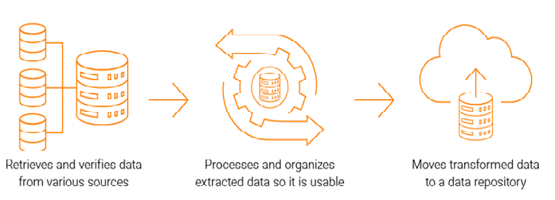
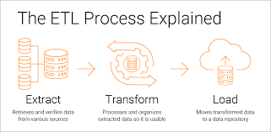
I . Data Integration and Processing
Step 1 of data management life-cycle
Raw data ingestion from sources like
Web APIs
Mobile Apps
IOT devices
Forms
Surveys
Once ingested, what next to be done?
Can we use the data as such?
What is this?
Historically been the standard method to integrate and organize data across different datasets

Slide 18
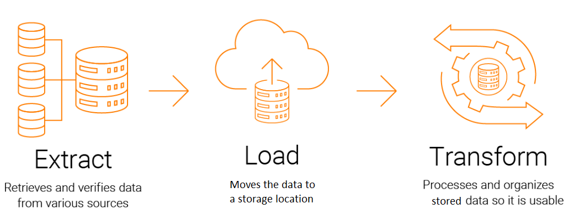
I. Data Integration and Processing - contd
Now what is the problem with ETL?
With growing trends in data
Are our data always structured? YES / NO
NO
Can ETL cater to the growing velocity? YES / NO
NO
Can it work for real-time data flow? YES / NO
NO
Popular because of
Advancement in cloud infrastructure
Need for real-time data
SOLUTION to ETL short comings

Slide 19
I. Data Integration and Processing - contd
Can we directly consume the extracted data? YES/NO – still the question is not answered
NO
Next Steps to be done
Filtered
Merged
Aggregated
For what ?
For the applications that can range from a business intelligence dashboard to a predictive machine learning algorithm

Slide 20
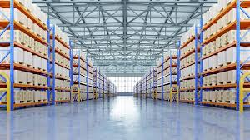

II. Data Storage
When?
Data should / can be stored before / after data processing
Deciders
Type & Purpose of the data
Warehouse
Lake
What do you infer?
Which is structured and which is unstructured here?
Where will you use these?

Slide 21
II. Data Storage
Data Warehouse
Data Lake
Required a defined schema
Mostly Relational system or RDBMS
Optimized for high performance analytics or structured data
Use cases:
Data analytics dashboards
Business intelligence tasks
Data visualization
No defined schema.
Comes handy for semi-structured & unstructured data
Optimized for costs and multi – type sources
Use cases:
AI
Analytics at a scale
Sandbox for innovative data projects
+
=
Data Lakehouse

Slide 22
III. Data Governance
Why?
Promotes :
Availability
What?
A set of standards and business processes which ensure that data assets are leveraged effectively within an organization
Includes
Usage
Ensures Compliance
Processes
Policies
Tools
Ensures
Data Quality
Data Access
Data Usability
Data Security
Who does all these?
Data Governance Councils
Sample activities of data governance councils
They align taxonomies to help ensure that metadata is added consistently across various data sources
What is metadata?
Data about data.
Define roles and responsibilities to help ensure that data access is provided appropriately

Slide 23
IV. Data Security
Define roles and responsibilities to help ensure that data access is provided appropriately
What does this means?
Can you see the salary slip of your colleague?
Can you see the medical reports of a fellow patient?
This means controlled access is particularly important to maintain data privacy.
Data security sets guardrails in place to protect digital information from unauthorized access, corruption or theft
Why?
To help protect customer data from cybercriminals or to help prevent incidents that need disaster recovery
Data Loss can be devastating to any business, data breaches, in particular, can result in costly consequences from both a financial and brand standpoint
How?
More scrutiny is placed upon the security practices of modern businesses
Secure their data by using encryption and data masking within their data security strategy

Slide 24
Data Platform

Slide 25
Data Platform
Definitions:
A software suite that enables organizations to process and manage large amounts of data quickly and efficiently. It manages data collection, normalization, transformation, and application for a given data product.
A central repository and processing house for all the organization’s data.
A collection of data pipelines that ingest data, store it, transform it, and deliver it to a variety of destinations so the data can be consumed by different enterprise groups for their purposes.
Why:
Data management tools require a robust data and computing infrastructure that scales to meet business demand without impacting performance
To achieve:
Data environments require
Fast query processing
Large storage capacity
Elastic computing
In-memory caches
Massively parallel query processing
Columnar storage
and Large in-memory data grids and computing clusters

Slide 26
DM Components

Slide 27
Framework
Data Governance
Provides the overarching support to data management through stewardship, policies, processes, standards, and adherence to leading practices
Supports the needs of the business to share data internally and externally.
Data Privacy
Data Architecture
Provides the infrastructure for the storage, integration, and use of data throughout the organization
Data Management
Applies statistical and visualization techniques that lead to valuable insights that can help the company make better business decisions.
Analytics
MetaData
Allows to use data more efficiently by providing critical information about data attributes
Data LifeCycle
Data Quality
Allows the data throughout the company, providing integrity from the initial introduction into the company through the final deletion from the company
Provides the structure necessary to have data that fulfills the needs of the business

Slide 28
Phases in Data Life-cycle

Slide 29
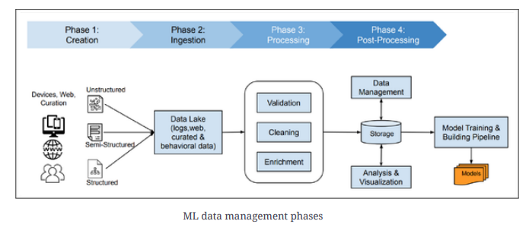
Phases

Slide 30
Phases
Generation/ Creation
Ingestion
Processing
Post – Processing
Various sources of data – devices, audio, text, images, videos
Creation / availability of data
Collecting the data
Sampling, filtering, selecting and validation
Validation
Cleaning
Enrichment
Storage
Visualization
Machine Learning

Slide 31
Generation / Creation
From where the data comes?
Datasets are all created at some point via some process
What is data generation or creation?
The process of generating or capturing the data in some data storage system but not our data storage system
Examples
Logs from serving systems, large collections of images captured from an event, diagnostic data from medical procedures
Some datasets work well when they are static (or at least don’t change quickly), & others are useful when frequently updated
A photo-recognition dataset, may be usable for many months, as long as it is suitably representative of the types of photos would like to recognize with model.
On the other hand, if the outside photos represent only winter environments from a temperate climate, the distribution of the photo set will be significantly diversified

Slide 32
Ingestion
The data needs to be received into the system and written to storage for further processing
Can we take all data that was created / generated at source?
A filtering and selection step necessarily occurs
Sampling
may also simply sample at this stage if have so much data which can not be processed
an effective way to save money on intermediate processing and training costs
important to measure the quality cost f sampling and compare that to the savings
is likely to occasionally loose some detail for some events – unavoidable!
In general, ML training systems perform better with more data. Any reduction in data may well impact quality at the same time as reducing costs.
How?
Depending on the volume of data and the complexity of our service in the ingestion phase
APIs / Remote Procedure Calls that gives data in required format and also confirm the data lineage
Reliability concerns during the ingestion phase typically focus on correctness and throughput

Slide 33
Processing
What will happen to ML if we have bad data?
Solution : Validate the incoming data
Data ingested from external sources might have a lot of errors
extremely important to validate the incoming data especially when there is a well-defined schema and/or an ability to compare against the last known valid feed
performed against a common definition of the field
What will happen if the data has missing fields, duplicates, misclassifications, or even encoding errors?
Solution: Clean them
What if the data is not consistent?
Solution: Normalize the data or bucket the data(map a range of data into a much smaller set of groups that represent the same range)
What if you think the data is not rich enough but available?
Solution : Enrich & extend
Combine with data from other sources – Enrich and Join
Identify given event or record – through Labels

Slide 34
Post - processing
Storage:
Visualization:
Should store the processed data somewhere.
How to decide that?
Efficiency of the storage systems
driven by access patterns that are driven by the model structure, team structure, and training process
Metadata - helps humans interact with the storage
When multiple people work on building models on the same data (or when the same person works on this
over time), metadata about the stored features provides huge value
How much importance do you give to detail on metadata?
Process of transforming large amounts of data into an easy-to-navigate representation using statistical and/or graphical techniques and tools
Not enough just to show a pie chart or bar graph
Need to provide the human reader an explanation of
what each record in the dataset means,
how it is linked with the records in other datasets
and whether it is clean and safe to use for training models
Why is this needed?
How many times we really go through the data in detail and rather depends on a data story board!
Machine Learning:
Using the data for future growth
Acting cautiously

Slide 35
Data Roles

Slide 36
Key Roles
Data Analyst
Collect, clean data from various sources
Exploratory analysis
Report Preparation
Data Engineer
Manage DBMS
Develop & maintain data pipelines
Data Scientist
Develop & maintain statistical & ML Models
Conduct analysis for deep insights
Data Architect
Create & maintain organisations data blueprint and data systems
DB Admin
Install & manage DB systems on infra
BI Analysts
Focus on business insights and reporting

Slide 37
Connecting Dots

Slide 38
Data Engineering
From our primary understanding of data management – this is the first concept that we need to understand
Let us reiterate what we do here?
Design
Collect
Analytics
Build
Transform
Data Science
For
For
Maintain
Store
Machine Learning

Slide 39
Data Engineering
Think of it like building a car
Design
Plan the car’s structure
Collect
Fueling the car
Analytics
Monitor Car Status
Build
Assemble the parts
Transform
Burning Fuel to power the engine
Data Science
Study past data to make better decisions
For
For
Maintain
Fix issues and upgrade as needed
Store
Parking the car into a garage
Machine Learning
Teach the car to drive smarter on its own

Slide 40
Case Study
Consider an ecommerce company which wants to understand the customers’ shopping interest and want to implement personalized recommendation engine
Can you say how will you start and what will you do in this scenario?
What is/are missing here?
What is/are missing here?
Data Engineering
Look into data sources, cleaning logic, storage
Schedulers to collect the data and feed the data to the recommendation engine
Maintain
Raise alarms
Work on CRs if there are any changes
Business acumen
Data models
Holistic view
Design
Orchestration
Overall data platform
Data Architecture
Privacy
Security
Monitoring & logging
Lifecycle
Governance

Slide 41
Conceptual Relationship
Data Architecture
Blueprints, Standards,
Data Models,
Integration Flows
Data Engineering
Pipelines,
ETL/ELT, APIs,
Streaming, Orchestration
Big Data
Volume, Velocity, Variety, Distributed Ecosystems
Data Governance
Quality, Compliance, Metadata, Stewardship, Security

Slide 42
References:
Source : trellance
https://www.ibm.com/in-en/topics/data-management
https://medium.com/@icaro_vazquez/what-is-a-data-platform-081549a2cef6
DMBOK
Reliable Machine Learning By Chen, Murphy, Sculley, Underwood

Slide 43
Thank You!

